Slide 1
HANDSHAKE COMMUNICATION

Slide 2
AIM OF THE PROJECT
Implementing the handshake communication between two raspberry pi boards using serial communication protocols(SPI,I2C,UART).

Slide 3
UNDERSTANDING HANDSHAKE COMMUNICATION
Handshake communication is a method for devices to establish a communication protocol , enabling data transfer. And ensures readiness for data transfer , confirming both devices are prepared.

Slide 4
Understanding uart protocol
UART is a hardware communication protocol facilitating asynchronous serial data transmission .
It is a two-wire communication protocol [TX and RX] .
UART operates without clock signal using start and stop bit for data framing.
UART supports multiple baud rates , with 9600 and 115200 being the most prevalent.

Slide 5
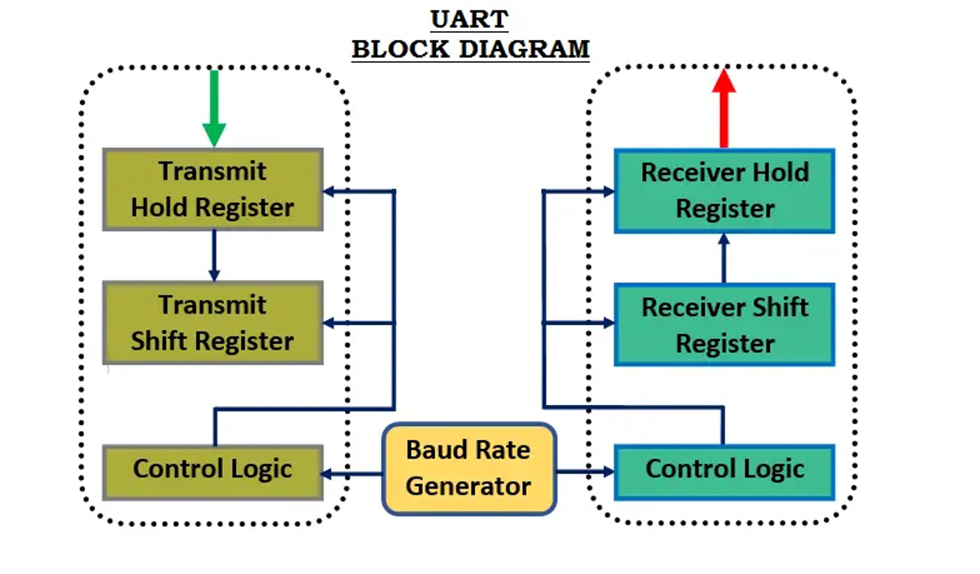
UART BLOCK DIAGRAM

Slide 6
UART master slave connection
TX and RX lines are vital for communication between master and slave devices.
A stable ground connection is essential for maintaining signal integrity during data transmission.
Additional control signals like RTS (request to send) can facilitate handshake between deivces.

Slide 7
UNDERSTANDING OF SPI
SPI , or serial peripheral interface , is synchronous serial communication protocol ideal for short distance applications.
It is 4 wire protocol MOSI , MISO, CLK and CS(select the slave).
SPI allows full duplex communication , enabling simultaneous data transmission and reception.
SPI supports multiple slave devices controlled by a single master device , enhancing flexibility in system design.

Slide 8
SPI BLOCK DIARAM
MOSI
MISO
SCLK
CS
nmmmnlkk
MASTER
SLAVE

Slide 9
UNDERSTANDING I2C PROTOCOL
I2C stands for inter integrated circuit designed by Phillips (now NXP).
It is 2 wire communication protocol SDA (data line) for data transmission and reception SCL(clock line) for synchronization .
It is half duplex synchronous communication protocol because through SDA line can send the data either master or slave both cannot send at a time.
I2C supports different data transfer rates 100kbps() , 400kbps() , 1mbps() and 3.4mbps().
It supports multi master and multi slave connection.

Slide 10
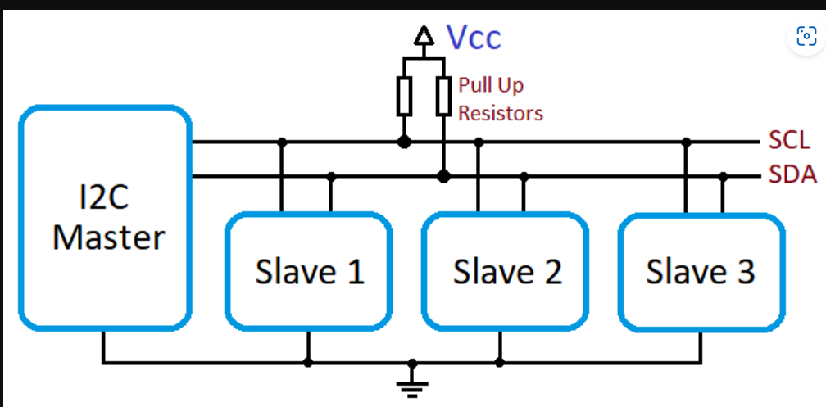
I2C BLOCK DIAGRAM

Slide 11
COMPARISON BETWEEN UART , SPI AND I2C
UART | SPI | I2C
UART is asynchronous communication protocol. | SPI is synchronous communication protocol. | I2C is synchronous communication protocol.
Peer to peer communication | multi slave Communication | Multi master and multi slave
Full duplex. | Full duplex. | Half duplex.
2 wire protocol. | 4 wire protocol. | 2 wire protocol.
Used for long distance. | Used for high-speed data transfer. | Used for sensor interfacing.
Moderate speed. | High speed. | Moderate speed.

Slide 12
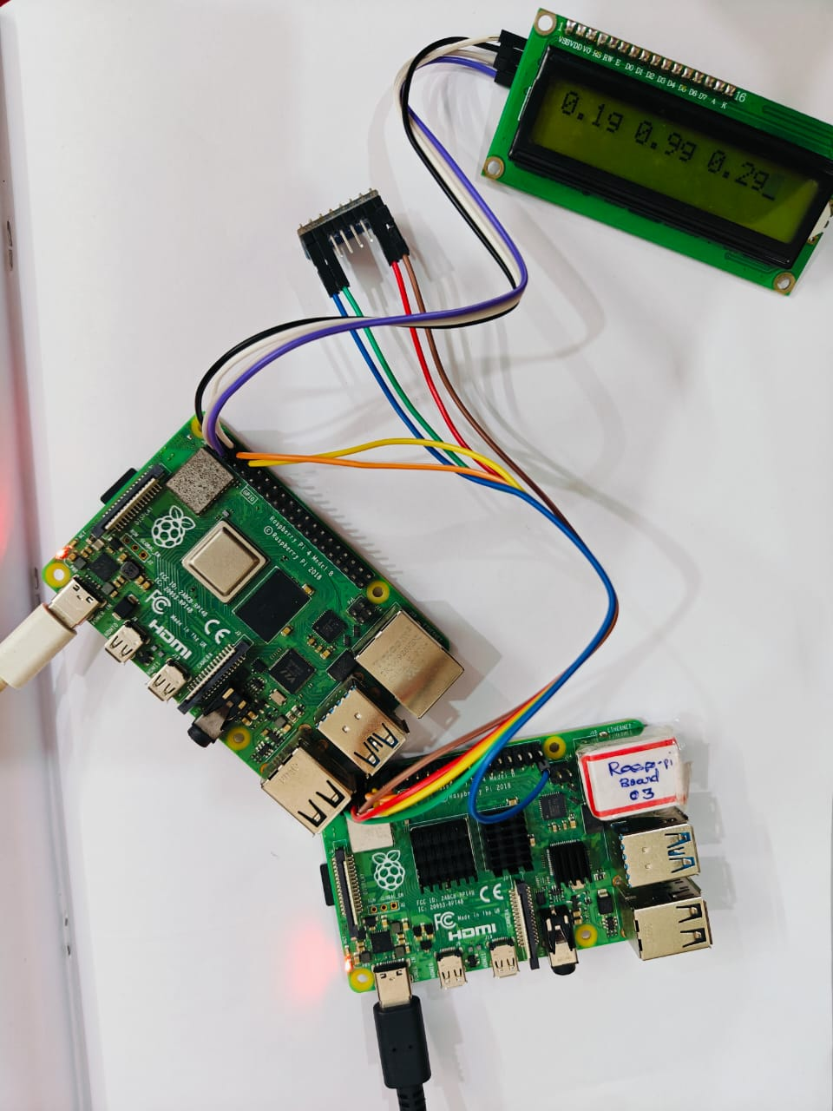
OUTPUT ACHIEVED

Slide 13
THANK YOU

